Slide 1


Population Prediction
Machine learning project to Explore U.s State Population

Slide 2
INPUT Features
Deaths
Births
Domestic Migration
International Migration
Unemployment Rate
Civilian Labor Force

Slide 3

Explain the model
International
Migration
Civilian Labor Force
Multiple Linear Regression Model
Domestic Migration
Unemployment Rate
Births
Deaths

Slide 4
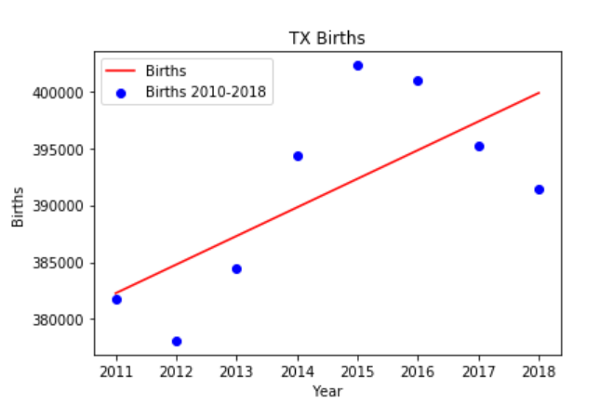
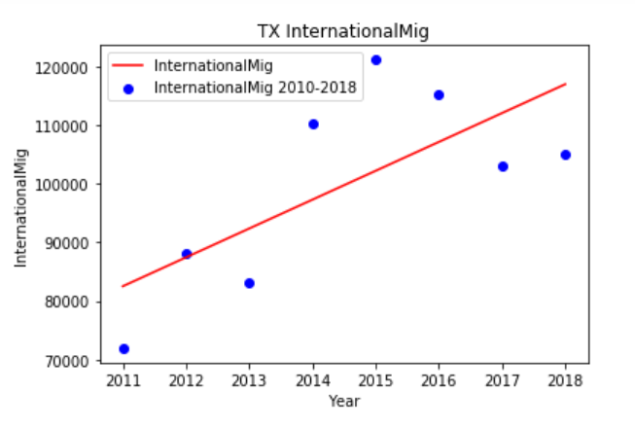
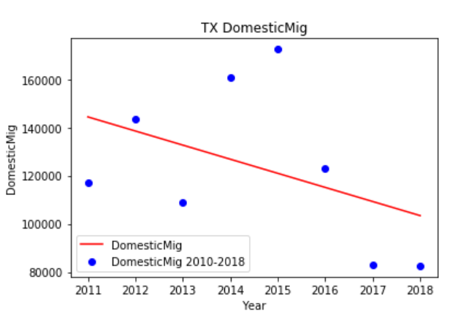
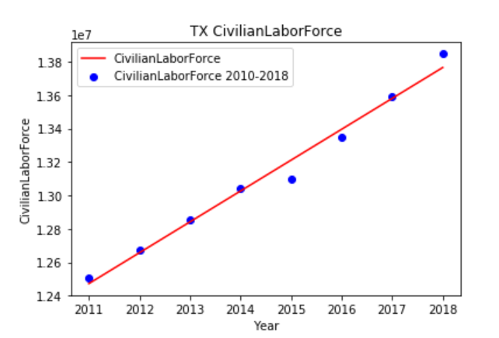
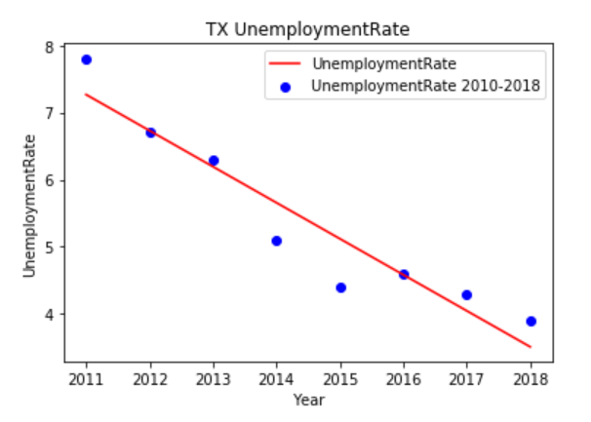
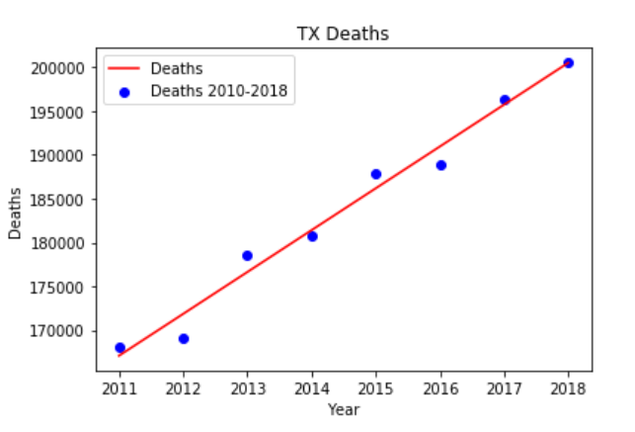
Linear Regression Models to Predict our input features

Slide 5
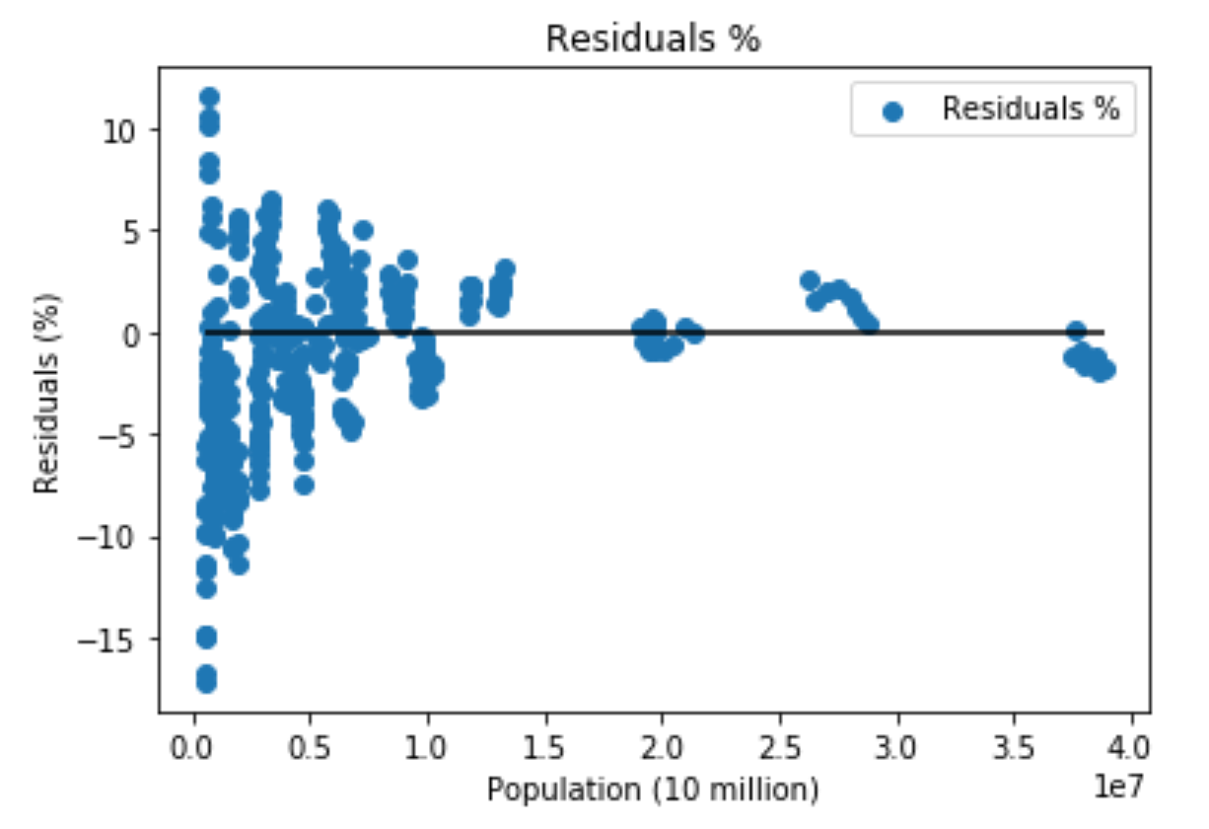
Predicted vs. Actual
Model Score: .99939
408 data points
8 years of Data for all States

Slide 6
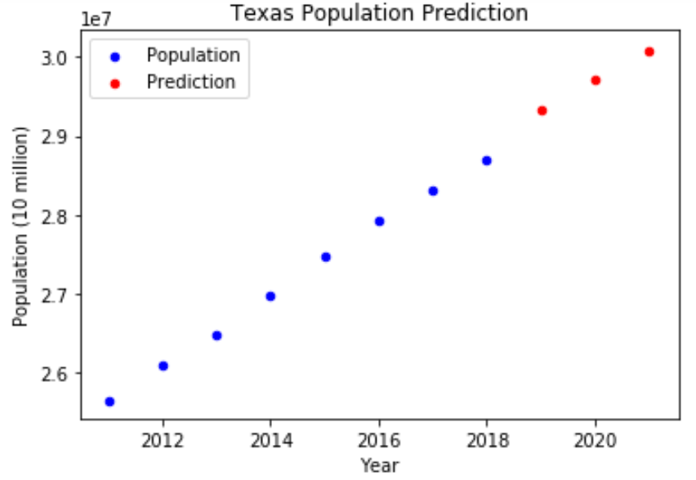
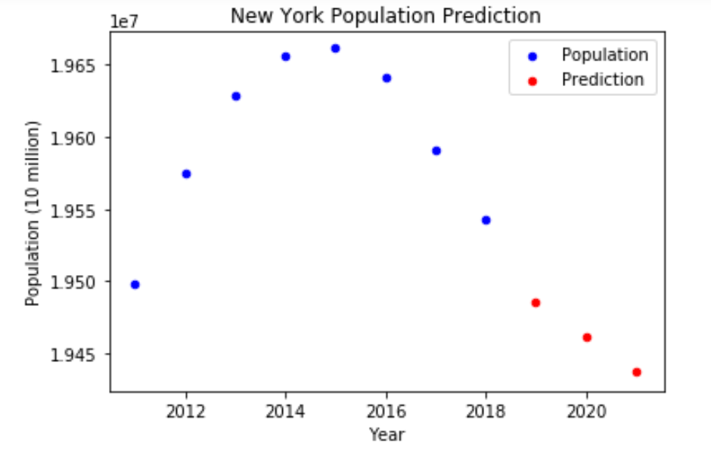
Prediction of population by state

Slide 7
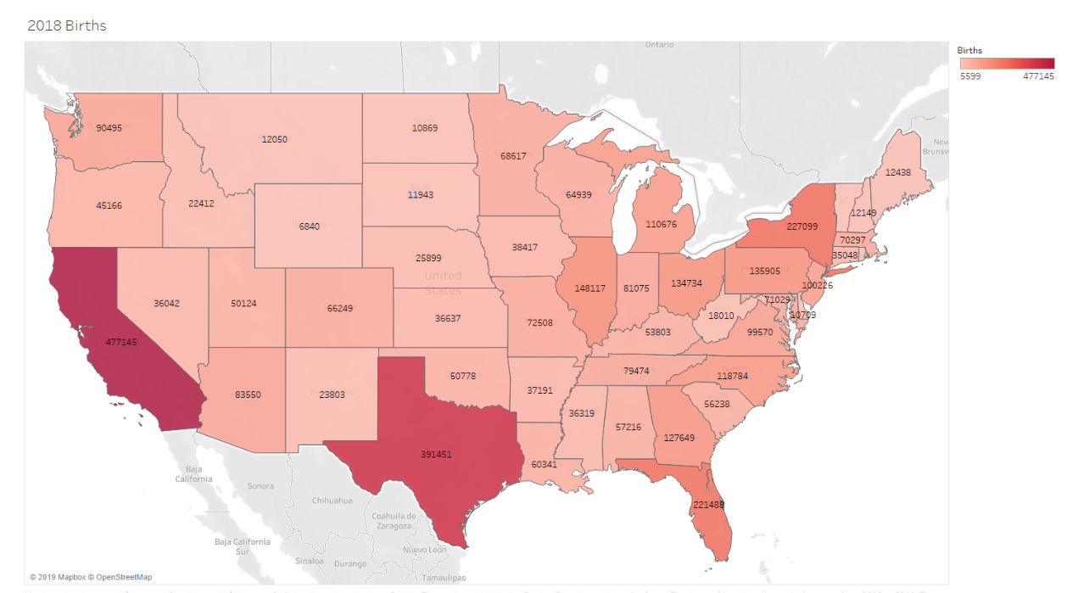
Births

Slide 8
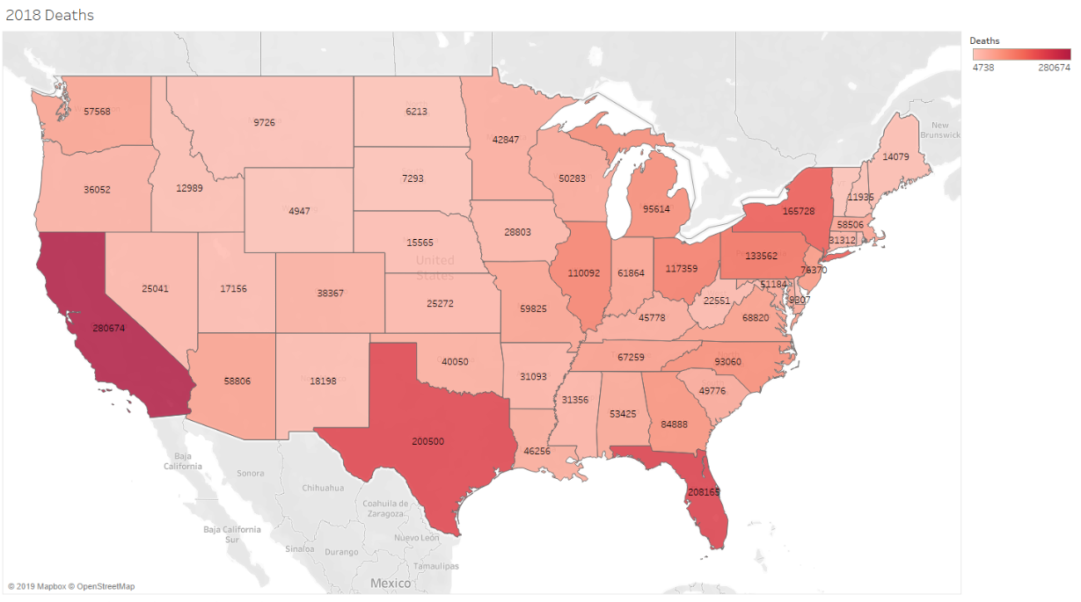
Deaths

Slide 9
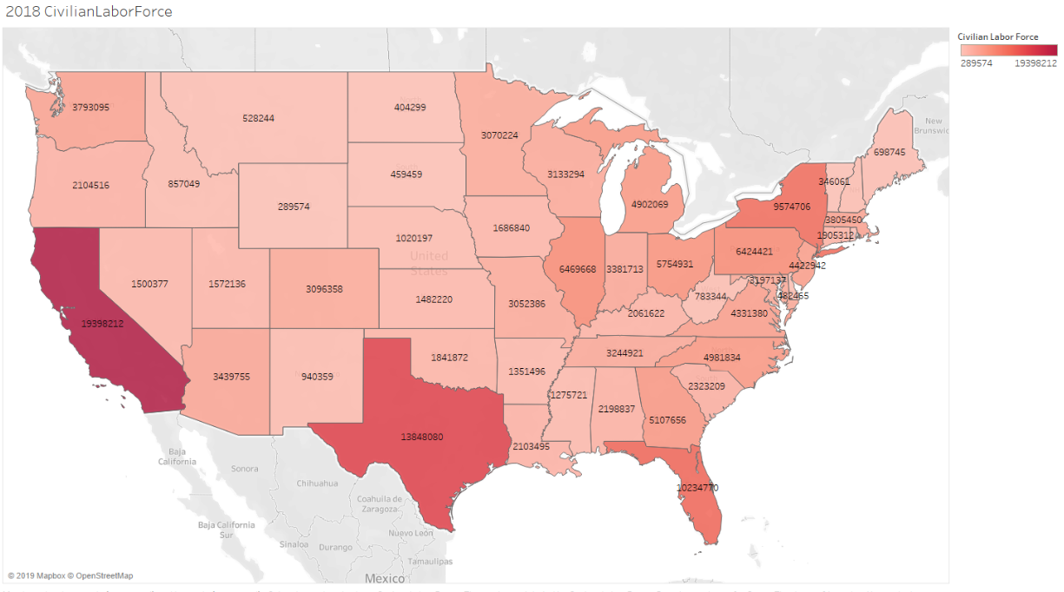
Labor Force

Slide 10
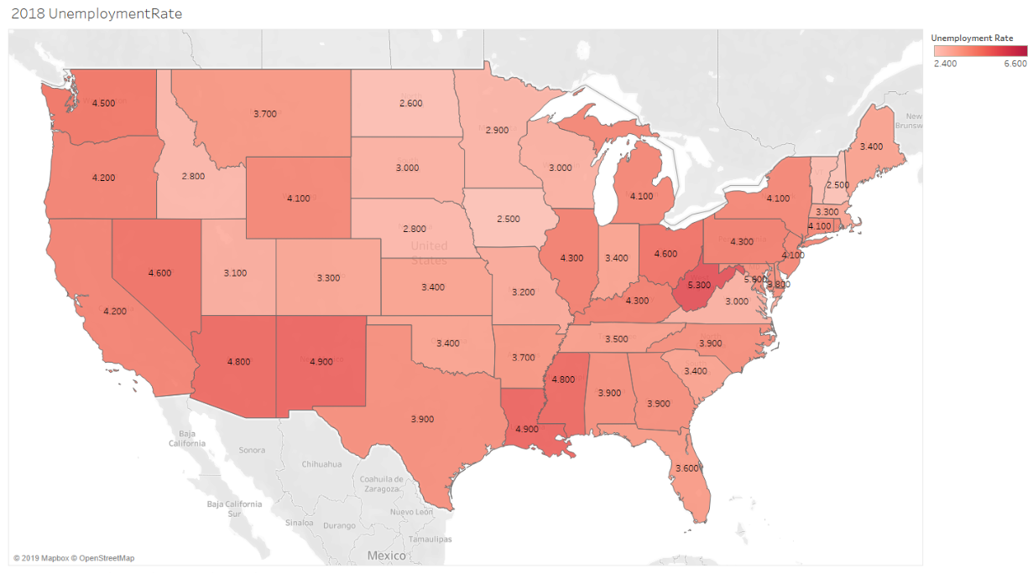
Unemployment rate

Slide 11
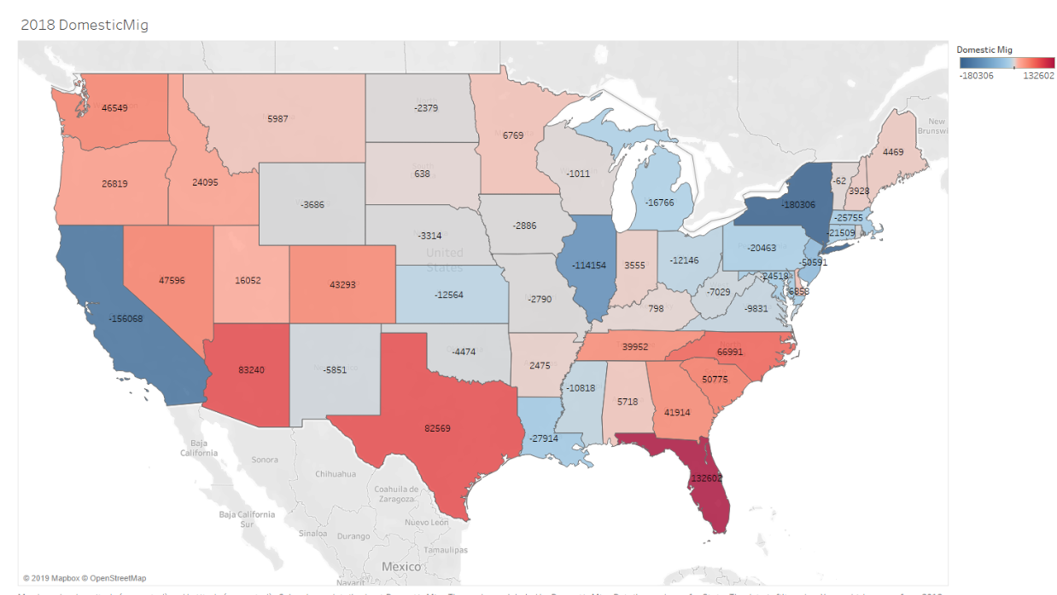
Domestic Migration

Slide 12
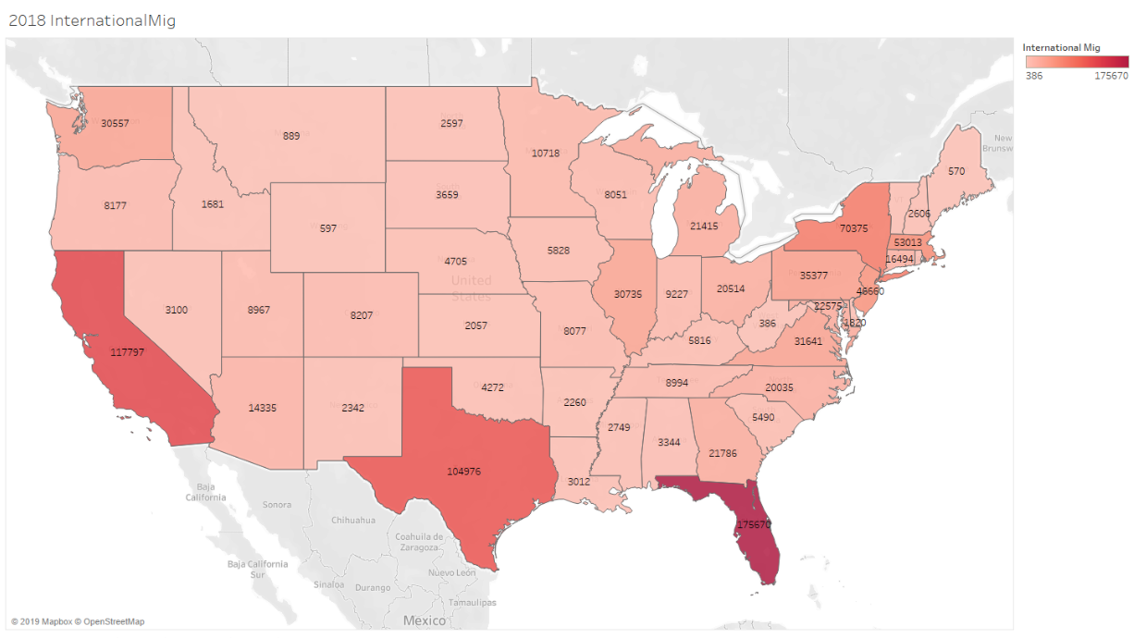
International Migration

Slide 13
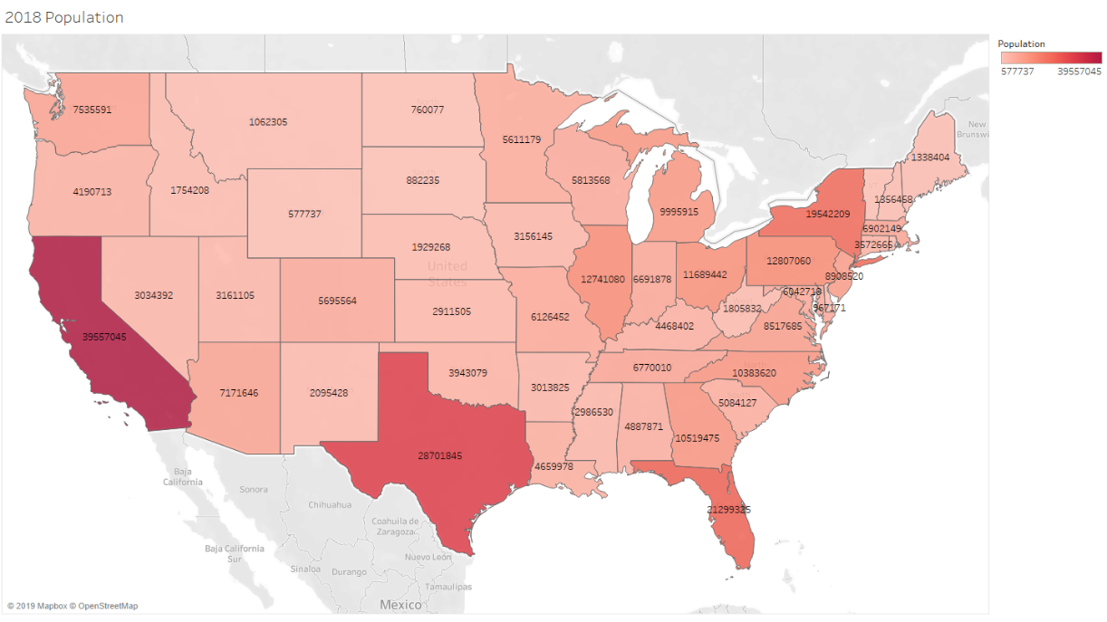
2018 pop.

Slide 14
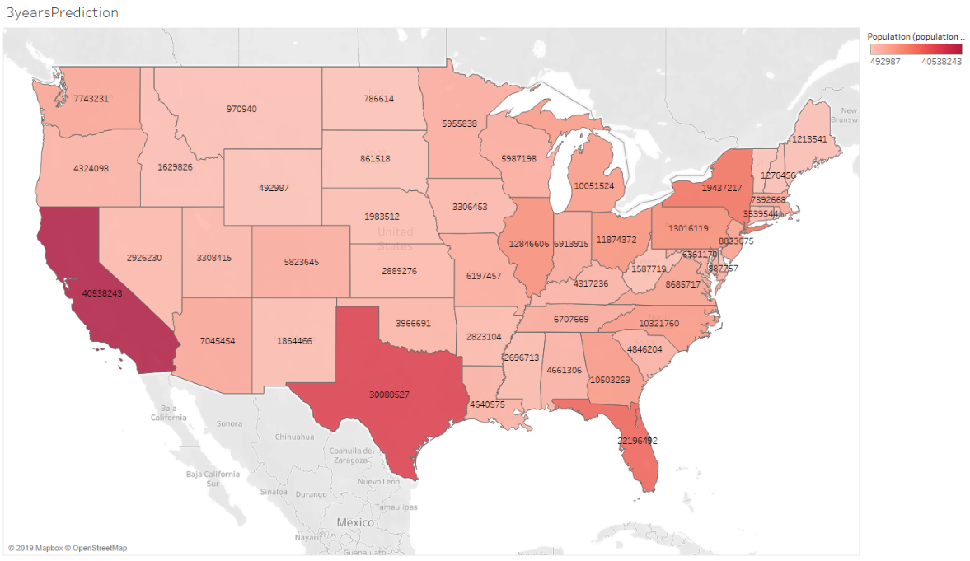
3 Year prediction

Slide 15
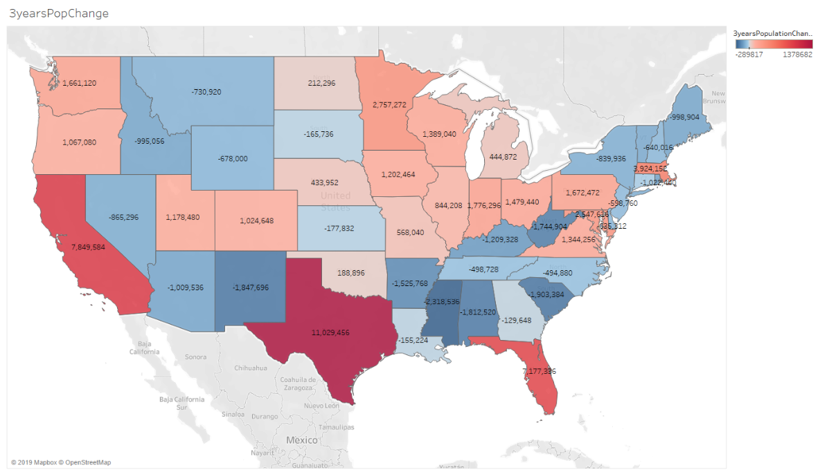
3 year pop change

Slide 16
Questions

